Slide 1

Multi Camera Tracking Project
Spring 2025 – Biweekly progress

Slide 2
Content
Recap of previous week
Current progress
Next steps

Slide 3
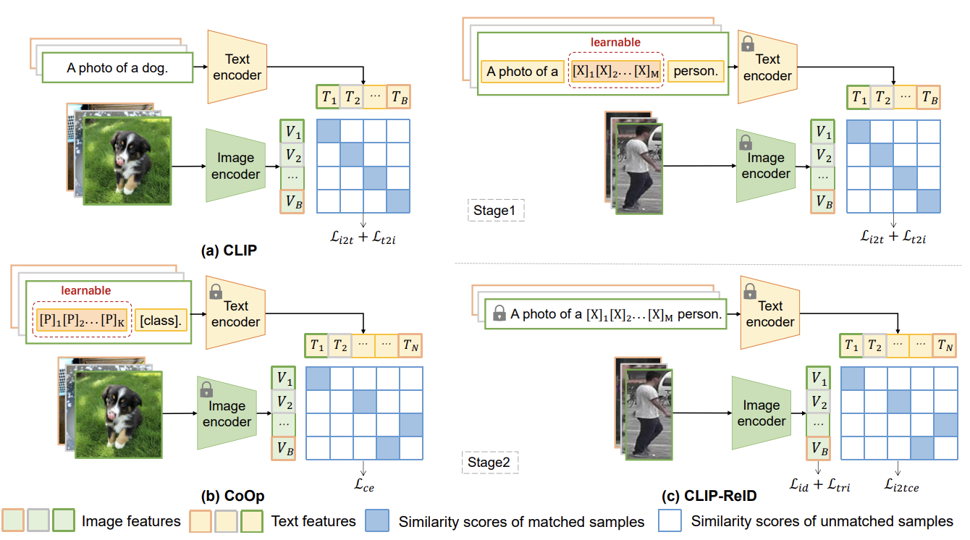
Recap – Literature Review on CLIP-ReID
Stage 1: Learnable Text Token Optimization
Fixed image and text encoders
Optimization of learnable text tokens
Contrastive loss similar to CLIP
Stage 2: Image Encoder Fine-tuning
Fixed text tokens and text encoder
Fine-tuning of image encoder
ID loss and triplet loss
Cross-modality image-to-text cross-entropy loss

Slide 4
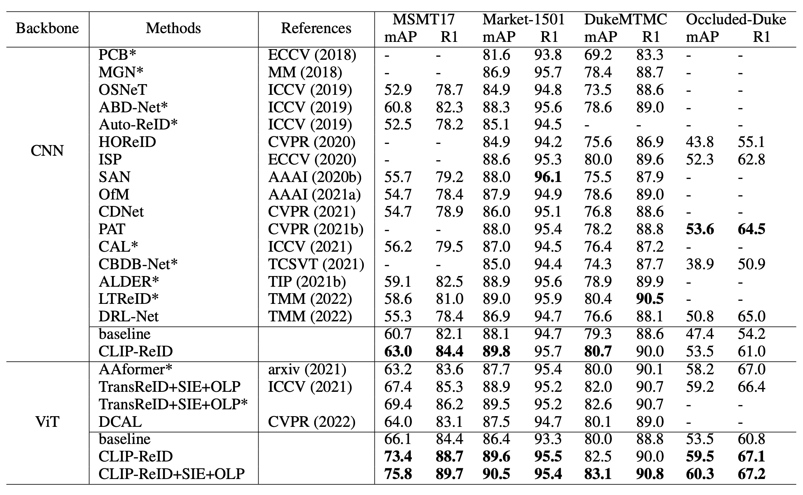
CLIP-ReID – State of the art comparison
43% in mAP
14% R1(rank1 accuracy)

Slide 5
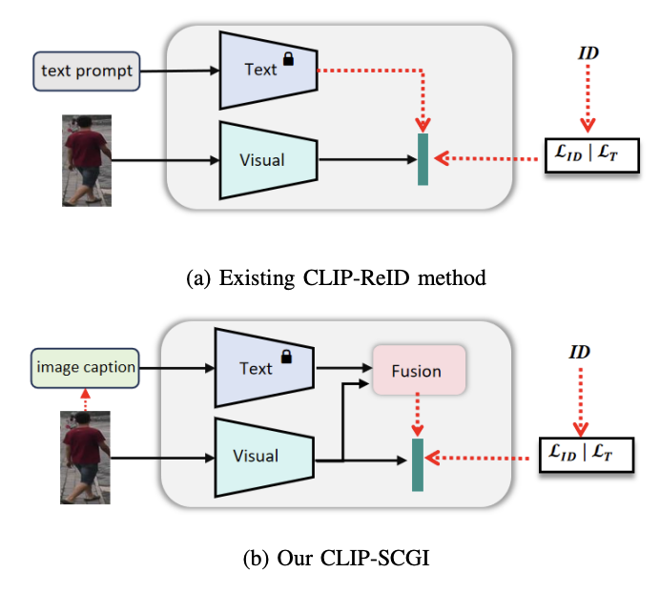
Recap – Literature Review on CLIP-SCGI
CLIP-ReID uses predefined ID tokens along with simple text prompts.
Absence of concrete descriptions that capture key semantic attributes such as gender, clothing, and age. Solution :
Leverage existing image captioning models(LLaVA) to generate pseudo captions for person images, to boost person re-identification using Vision language models (CLIP)
CLIP-ReID
CLIP-SCGI

Slide 6
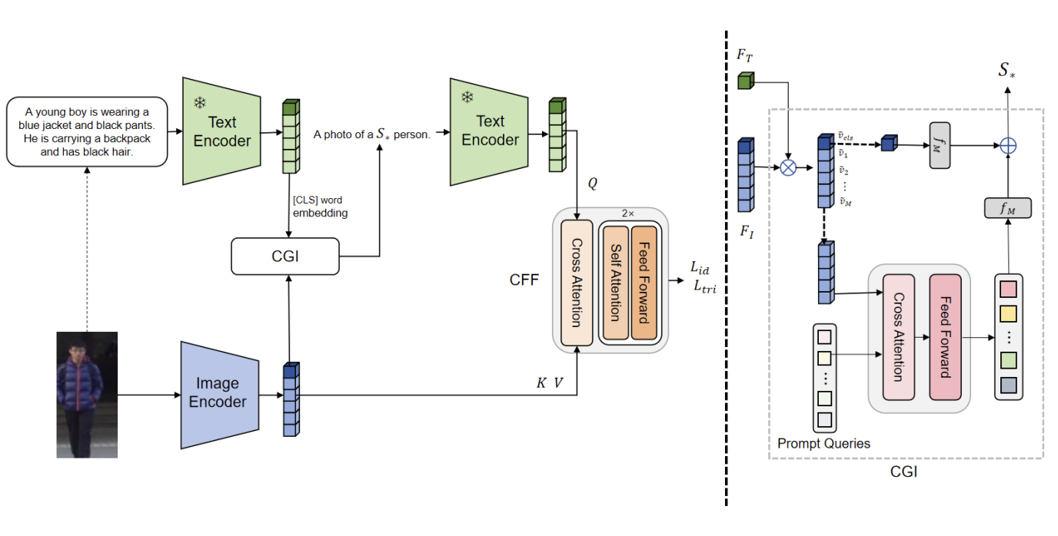
CLIP-SGCI :Methodology

Slide 7
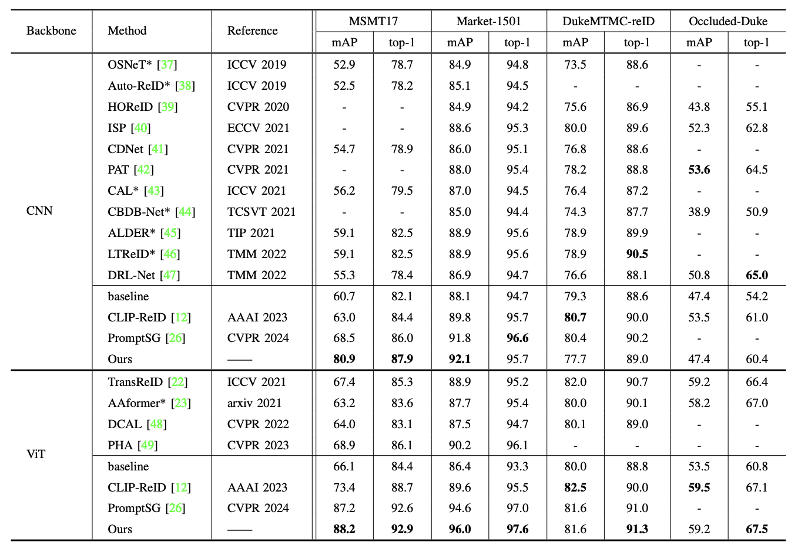
CLIP-SCGI –Comparison to State-of-the-Art
CLIP-SCGI has 26% higher parameters than CLIP-ReID
No increase in training time for one-stage approach compared to the two-stage CLIP-ReID.
Recap – Literature Review on CLIP-SCGI​

Slide 8
Progress so far
Setup Code bases for CLIP-ReID
Fixed CLIP-ReID issues (Downloading models from web, system dependency of turtle GUI)
Trained and evaluated CLIP-ReID on Market-1501 dataset and replicated results
Conducted experiments on lowes ReID data using both methods(OsNeT , CLIP-ReID).
Compared the perfromance of OSNet(baseline) and CLIP-ReID on both Market-1501 and lowes dataset

Slide 9
Performance of CLIP-ReID & OsNeT on Market-1501
Method | mAP | Top-1 Accuracy
OsNET | 85.3% | 93.8%
CLIP-ReID | 89.8% | 95.3%
CLIP-ReID+SIE+OLP | 96.6% | 99.9%
CLIP-ReID outperforms OsNET by 13.2% In mAP and 6.5% in Top-1Accuracy

Slide 10
Performance of lowes data on CLIP-ReID & OsNeT
Method | mAP | Top-1 Accuracy
OsNET | 95.8% | 98.3%
CLIP-ReID | 96.6% | 98.3%
CLIP-ReID+SIE+OLP | 96.6% | 98.2%
Here the results seems to be almost same with both methods . I will explain that in terms of qualitative examples of query and test images

Slide 11
Market –1501 : Query & Test examples

Slide 12
Lowe's Data : Query & Test examples

Slide 13
CLIP-ReID– Takeaways
Q. Should we use CLIP-ReID features instead of OSNeT features ?
A. Results show CLIP-ReID is better than OsNeT on both public (Market-1501) and our Lowe's dataset
Few Limitations on Lowe's dataset :
Query images had data from only one camera
Need data from multiple cameras to assess better

Slide 14
How to improve CLIP-ReID?
One of recent CLIP based method (CLIP-SCGI) has shown using synthetic captions instead of static text to all the person ID.
CLIP-SCGI uses image captioner LLaVA (A large language vision model) to generate person specific captions.
On top of CLIP-ReID , CLIP-SCGI uses Caption Guided inversion and Fusion module .
The objective function remains same as CLIP-ReID (ID loss + Triplet loss + contrastive loss)

Slide 15
CLIP-SCGI - Challenges
Open-source implementation is not available
Develop the modules from scratch which is time consuming .
Preprocessing involves extracting captions using LLM which is an overhead.
Based on the performance of CLIP-ReID on lowe's data . Should we explore the implementation aspect of CLIP-SCGI

Slide 16
Next Steps
​
Evaluate CLIP-ReID on Lowe's data which contains multi camera data.
Extract CLIP-ReID features and replace them with the OSNeT features in existing Multi camera tracking pipeline
Perform end-to-end tracking after replacing CLIP-ReID component. ​

